Slide 1
GridBagLayout

Slide 2
GridbagLayout
A GridBagLayout breaks the JFrame into a grid
The coordinates of the grid start from the top left at x = 0 and y = 0
It takes some getting used to, but the number of rows and columns are essentially infinite. However, every row has a height of 0 and every column has a width of 0 until a component is added.
Each column will be as wide as the widest object in that column and each row will be as tall as the tallest object in that row.

Slide 3
GridbagConstraints
GridBagLayout requires a GridBagConstraints object. The constraints tell the layout how to add an object to the frame.
The GridBagConstraints object has several public fields that allow you to control how the components are added. Primarily we use the gridx and gridy to control where the object is added.

Slide 4
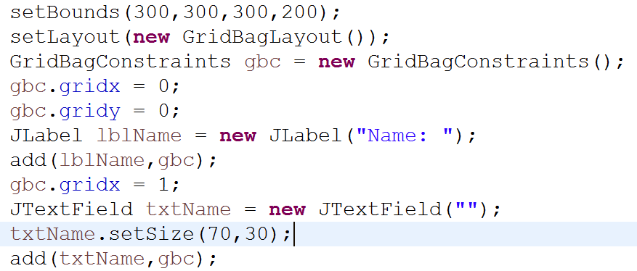
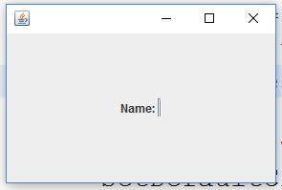
Example
This code adds a Jlabel at gridx = 0 and gridy = 0 and a JTextField at gridx = 1 and gridy = 0. Notice the text box has virtually no width despite the fact that I set that I set the width. This is because the GridBagLayout will automatically make objects as small as possible.

Slide 5
Setting the size
The setPreferredSize method will solve the issue. Unfortunately if doesn’t take integer parameters, it takes a Dimension object as parameter. The dimension constructor works as we would expect with an int for width and an int for height.

Slide 6
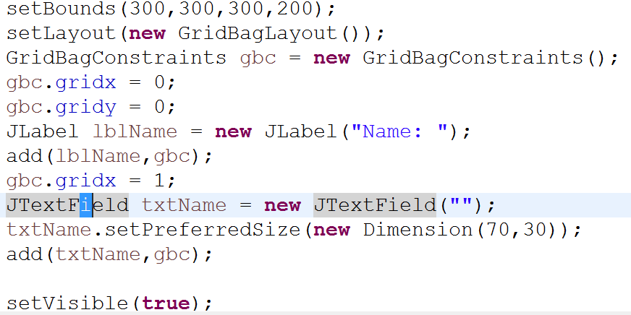
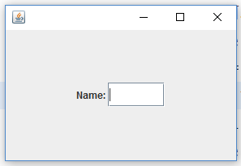
solution

Slide 7
Width demonstrated
Changing the gridx of the text field to 3 we expect to see a spame between the label and text field. However this is the result:
It didn’t change. This is because columns at 1 and 2 have nothing in them and therefor have a width of 0.

Slide 8
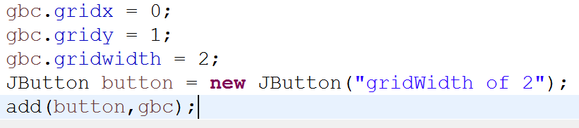
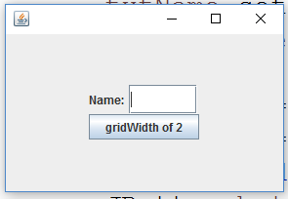
Gridwidth and gridheight
gridWidth and gridHeight can be useful but do not change the height and width of any cell in the grid. Rather, it determines how many cells an object will occupy.

